Slide 1

Crédula Tiars Hiara et Crédula Playakrts. (2006)

Slide 2

We’re Floating Away (2009)

Slide 3
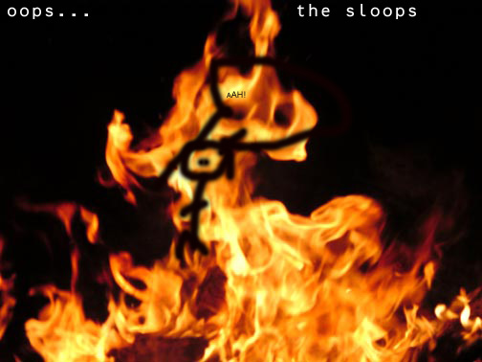
Oops… (2010)

Slide 4
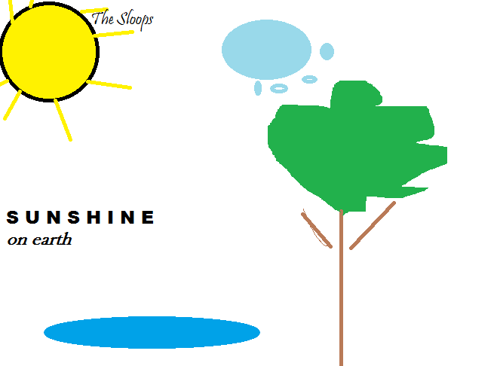
Sunshine On Earth (2012)

Slide 5

Honeycombs (2013)

Slide 6
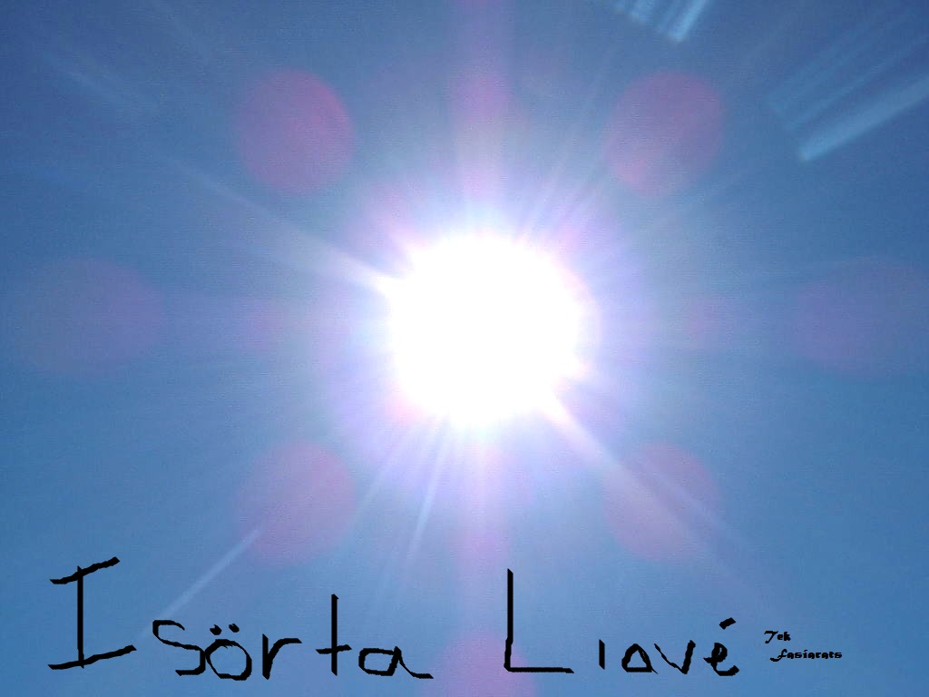
Isörta Liavé (2014)

Slide 7

In The Moment (2015)

